Slide 1

Servant Leadership

Slide 2
Definition of Leadership
The Oxford English Dictionary defines a leader as:
…the person who leads or commands a group, organization, or country: the leader of a protest group a natural leader
Webster’s Dictionary
…the power or ability to lead other people

Slide 3
Definition of Leadership
"A leader is someone [who] leads by example and has the integrity to do the right thing even when it is not popular. A good leader has positive influence over others, inspiring them to become a better person and example for others to model their life against, as well.“
– Mark Little, founder and president, Diversified Funding
"Leadership is the ability to guide others without force into a direction or decision that leaves them still feeling empowered and accomplished."
– Lisa Cash Hanson, CEO

Slide 4

or
Are Leaders…
Leadership trait theory is one of the earliest theories of leadership, which can be traced back to Thomas Carlyle’s 1849 assertion that “the history of the world was the biography of great men”.
It is the idea that there are certain inborn traits that make people more likely to succeed as leaders: in essence, it states that leaders are born, not made.
However, in 1948, a researcher called Stogdill noticed that people who were leaders in one situation were not necessarily leaders in other situations, which rather destroyed trait theory.

Slide 5

Different Leadership Styles
Autocratic Leadership (do as I say)
Democratic Leadership (do as I do)
3. Laissez-faire Leadership (do as you choose)
4. Strategic Leadership Style (follow my plan)
5. Transformational Leadership (this need to change)
5. Team Leadership (only this team counts)

Slide 6
Different Leadership Styles
7. Facilitative Leadership (results driven process)
8. Cross-Cultural Leadership (to effectively lead and inspire people across cultures.
9. Transactional Leadership (promote compliance by followers through rewards and punishments.)
10. Coaching Leadership (help others to advance their skills; and provide a lot of guidance.)
11. Charismatic Leadership (use their personality to conjure up enthusiasm in followers)
12. Visionary Leadership (leader inspire followers to move together towards a shared vision)

Slide 7
Definition of Servant Leadership
Servant leadership seeks to move management and personnel interaction away from "controlling activities" and toward a more synergistic relationship between parties.
The term "servant leadership" was coined by Robert Greenleaf, a twentieth century researcher
A servant leader is a person who focuses on enriching the lives of individuals and improving the organizations and communities they serve. They have the abilities to heal communities with their inclusive visions and bravery, even in the face of great adversity or danger.

Slide 8
Types of Leadership
Traditional vs. Servant
Traditional Leader–manages from ”top to bottom”
  Exercises power and control
  Most large company CEOs are traditional leaders
Servant Leader—leads from “bottom to top”
  Serves rather than controls
  Servant Leader focuses on the people
    Shares power
    Puts the needs of others first
    Helps people develop and perform to their highest potential
  Jesus was the consummate servant leader

Slide 9
Definition of Servant Leadership
  Servant Leadership is a DIFFERENT STYLE of Leadership, not new, but not used much
    Key Difference: the leader SERVES the needs of the followers, rather than BEING SERVED
It turns the traditional Leadership Pyramid upside down.

Slide 10
Leadership Pyramid
Traditional Leadership
Servant Leadership
Leader
Followers
Followers
Leader

Slide 11
Derivation of the Term
The phrase “servant leadership” was first coined by Robert K. Greenleaf in The Servant as Leader, an essay published in 1970.
Greenleaf researched what made some leaders great, Jesus Christ included and compiled 10 Principles or Characteristics of Servant Leadership

Slide 12
Biblical Foundation for Servant Leadership
Matthew 20:25-28…Jesus called them together and said, "You know that the rulers of the Gentiles lord it over them, and their high officials exercise authority over them. Not so with you. Instead, whoever wants to become great among you must be your servant”.
…”and whoever wants to be first must be your slave- just as the Son of Man did not come to be served, but to serve, and to give his life as a ransom for many”.

Slide 13
Consummate Act of Servitude
The consummate act of servant leadership was the washing of the feet of the apostles.
John 13:3-15…Jesus got up from the meal, took off his outer clothing, and wrapped a towel around his waist. He poured water into a basin and began to wash his disciples' feet, drying them with the towel.
…When he had finished washing their feet, he asked, "Do you understand what I have done for you? You call me 'Teacher' and 'Lord,' and rightly so, for that is what I am. Now that I, your Lord and Teacher, have washed your feet, you also should wash one another's feet. I have set you an example that you should do as I have done for you.”

Slide 14
Symbolism of Washing Feet
The washing of feet was a common practice upon entering a home
Background
  It was the task of a servant or slave
  When Jesus assumed this role, the disciples were probably stunned by this act of humility
Jesus’ basic motivation was love
He voluntarily became their servant
He set an example for servant leadership

Slide 15
The Greatest Leader of All Time
Jesus was the greatest leader of all time.
  Think about what he accomplished in just three years of public ministry.
  His leadership created a church that has existed for 2000 years.
  What other institution has lasted this long?
  What other leader has touched the lives of billions of people for over 20 centuries?
His is the style to emulate!

Slide 16
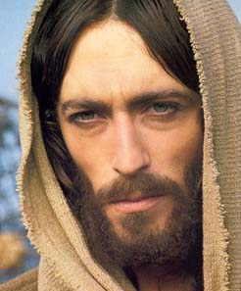
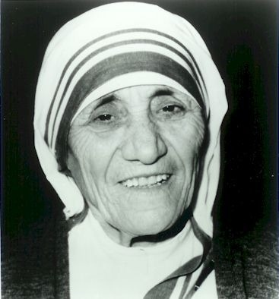
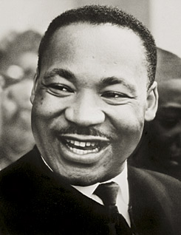
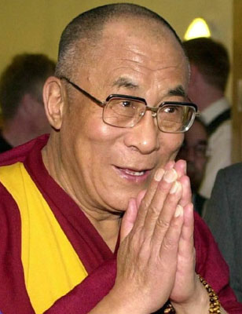
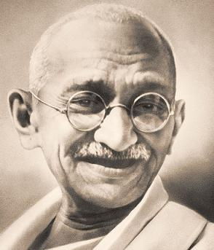
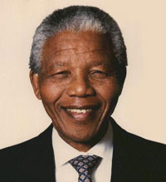
Servant Leaders
  Jesus Christ as example.
Religion
  Martin Luther King
  Mother Teresa
  Dalai Lama
other Areas
  Mahatma Gandhi
  Nelson Mandela

Slide 17
How Can We Learn to Lead Like Jesus?
Everyone has a leadership role: a mother, father, guardian, executive, manager, supervisor, church member, neighborhood or community leader.
We can all learn how to lead more effectively.
You already know the question, “WWJD—what would Jesus do?”
Now ask, “HWJDI—how would Jesus do it?”
Place more emphasis on the “heart” when making decisions, less on the “head”.

Slide 18
How Can We Learn to Lead Like Jesus?
There are TEN practices or characteristics that Jesus used in applying Servant Leadership. These practices can be studied and emulated by leaders at all levels.

Slide 19
Ten Principles of Servant Leadership
by Robert Greenleaf
1. They Listen - (listen receptively to what is being said (and not said)
Listen completely before deciding – BEFORE proposing changes, hear from representative parties. Proposing a solution and then asking what they think is not really listening – it’s telling them what you want asking them to align.
2. Empathy—(put yourself in the shoes of the other person)
Servant leaders are able to deeply understand and empathise with others. It is important to recognise and accept people for their uniqueness and understand their point of view.
3. Healing –(desire to be compassionate)
This does not mean physically healing but rather healing on a more holistic level. This can be achieved through discussion, coaching, mentoring and relationship-orientated leadership styles.
Jesus did not only heal physically but also spirituality and mentally.

Slide 20
Ten Principles of Servant Leadership
by Robert Greenleaf
Awareness – (tune in to what is happening around you)
Having a wider awareness of yourself and others is a common trait of effective servant leaders. Understanding strengths, weaknesses and areas for development and support is crucial for maximising performance.
5. Persuasion – (build consensus. Convince vs. coerce compliance)
A key difference between servant leadership and other styles of leadership is that servant leaders rely largely on persuasion and cooperation rather than authority and delegation. Servant leaders have an ability to convince others as opposed to coercing them into compliance.
6. Conceptualisation – (conceive a desirable vision, then lead in that direction)
Servant leaders have the ability to look at a problem from a conceptualising perspective, meaning they are able to think beyond the day-to-day realities of their work.

Slide 21
Ten Principles of Servant Leadership
by Robert Greenleaf
7. Foresight
Foresight is a characteristic which enables servant leaders to understand lessons from the past, the realities of the present, and the likely outcomes of any future decisions.
8. Stewardship- acknowledge and care for God’s gifts
Entrusted with resources of others
Guarantee a return on investments
9. Commitment to the Growth of People
- Help followers grow beyond their current skill levels
Servant leaders believe that people have an intrinsic value beyond that of the work they do. They lead with a deep committed to both the personal and professional growth of each and every individual within their organization.
10. Building Community- create a deeper desire for belonging, a bond that goes beyond a traditional organization, Servant leaders seek to identify ways in which social and task orientated communities can be built amongst those who work within their organisation. Effectiveness and Camaraderie

Slide 22
Learning to Lead Like Jesus
1. Values diverse opinions Seeks other points of view
  Accepts new and contrary opinions
  Example from the Bible?
    He surrounded himself with a diverse group of followers.
      Fishermen, a Tax Collector, a Zealot, Tradesmen
    He preached a message of salvation for everyone, Jew and Gentile.

Slide 23
Learning to Lead Like Jesus
2. Creates a culture of trust
Takes a person’s word at face value
  Believes that everyone will fulfill their roles
  Example from the Bible?
    Jesus was willing to invest in people others would have dismissed.
    Consider the disciples. They were not the “religious” elite, yet Jesus used them to start His church.
    Jesus released responsibility and ownership in a ministry.
    Consider how He sent the disciples out on their own. No micro-management it appears.

Slide 24
Learning to Lead Like Jesus
3. Develops other leaders (Cultivate Followers)
Teaches others to lead by example
  Delegates responsibility and authority
  Example from the Bible?
    He took a group of rag tag fishermen, farmers and tax collectors and turned them into consummate Evangelists.
      Peter, the fisherman, became leader of the church.

Slide 25
Learning to Lead Like Jesus
4. Helps people with life issues (Healing)
  Listens and shows compassion
  Concern for the total well-being of an individual
  Example from the Bible?
    Samaritan woman at the well
    Curing the blind man and other miracles-
    Jesus cared more about people than about “Church traditions/cultures.
    He was willing to jeopardize Himself personally by breaking the “ church traditions” to help someone in need.

Slide 26
Learning to Lead Like Jesus
5. Encourages followers
  Creates a “can do” attitude
  Plays the role of the “Cheer Leader”
  Example from the Bible?
    Jesus was into leadership development and replacement.
    He very purposefully prepared the disciples to take over the ministry. He pushed people beyond what they felt they were capable of doing.
    Asks Peter to “walk on water”
    Mary- from prostitute to deaconess

Slide 27
Learning to Lead Like Jesus
6. Sells instead of tells (Persuasive)
  Makes them want to do it
  Persuades rather than commands
  Example from the Bible?
    Without commanding them, the disciples followed Him

Slide 28
Learning to Lead Like Jesus
7. Thinks “you,” not “me.” (Empathy)
  Selfless, focus on others
  Emphasis on “we” versus “me”
  Exhibits empathy
  Example from the Bible?
    Jesus handled distractions with grace.
    When the woman who had been bleeding for 12 years touched His garment, Jesus stopped to heal her, even though headed to a definite purpose.
    He gave His life for others.

Slide 29
Learning to Lead Like Jesus
8. Thinks long-term (Foresight)
  Thinks about the future
  Keeps a foot in the present
  Example from the Bible?
  Jesus had a leadership succession plan.
  He consistently reminded the disciples He wouldn’t always be with them. Of course, He was still the “leader”, but He left others to take the ministry forward.

Slide 30
Learning to Lead Like Jesus
9. Acts with humility
  Doesn’t need a title or signs of power
  Follows the Golden Rule
  Willing to do whatever it takes
  Instinctively assumes the role of the “servant”.
  Example from the Bible?
    “Are you the King of the Jews? Thou sayeth it.”
    The Birth of Jesus
    Devil’s temptation on the mountain

Slide 31
Learning to Lead Like Jesus
10. Never Loses Sight of the Mission
    Maintains the perspective
    Plans effectively
    Establishes priorities
    Example from the Bible?
      Jesus was laser focused on His vision.
      Regardless of the persecutions or distractions, He kept on the mission God had called Him to complete.
      Jesus was into self-development, He grew in stature, knew the Scriptures and He constantly slipped away to spend time with God.

Slide 32
Servant Leadership
Praying—The path of men who are placed as leaders is not an easy one. But they are to see in every difficulty a call to prayer.
Never are they to fail of consulting the great Source of all wisdom. Strengthened and enlightened by the Master Worker, they will be enabled to stand firm against unholy influences and to discern right from wrong, good from evil.
They will approve that which God approves, and will strive earnestly against the introduction of wrong principles into His cause.
—Prophets and Kings, 31.

Slide 33
Paradoxes
Servant-Leadership, itself a paradox, requires a constant balance…
Great
But Without Pride
Planned
Yet Spontaneous
Compassionate
Balanced
Disciplined
Right
But able to say, “I’m Wrong”
Serious
Laugh
Wise
Admit You Don’t Know Everything
Busy
Make time to Listen
Strong
Yet Open To Change
Leading
And Serve at the same time
Introduction > Background > Characteristics > Paradoxes > Practice > Examples > More
†
© 2008 Benjamin Lichtenwalner
Notes:
Speaking Notes:
References:
Adapted from Brewer (as cited by Hansel), Spears, Greenleaf and Hunter

Slide 34
New Dimensions of Servant Leadership
The three dimensional model of the Servant Leader:
  Servant…provider of service
  Steward…guardian of God’s gifts
  Shepherd…protector of the served

Slide 35
Role of Servant
To serve, not to be served
To provide, not to be provided for
To help, not to be helped

Slide 36
Role of Steward
Holds a position of service
  Employee
  Parent
  Parishioner
Assumes responsibility for another’s property
  Caretaker or landlord
  Pastor
  Parish leader

Slide 37
Role of Shepherd
Protector of the “sheep”
Provider of nourishment
Source of love and comfort
Shepherd role requires that we love those we serve as a prerequisite to serving
“I am the good shepherd. The good shepherd lays down his life for the sheep.” ~John 10:11

Slide 38
The S3 Model of Leadership
Blends three inter-related roles of the leader:
  Servant…provider of service
  Steward…guardian of God’s gifts
  Shepherd…protector of those who are served and loved

Slide 39
Summary
Jesus was the most successful leader of all time. We can emulate His actions by following the ten practices He used.
.
.
Value diverse opinions
Cultivate trust
Develop other leaders
Help people with life issues
Offer encouragement
Sell instead of tell
Place ‘you’ ahead of ‘me’
Think long term
Act with humility
Never lose sight of mission & goal

Slide 40
Leadership Ethics
Leaders should be on time, honouring whatever appointment, and should communicate if they cannot make it, as …
Do not make promises you cannot keep, you may forget but others remember
Diarize appointments as soon as possible
It is always good to return a missed call or sent message to acknowledge
Evaluate yourself and Work on your weak spots
Leaders do not complain about their load/burdens to others, their family, friends
Confidentiality

Slide 41
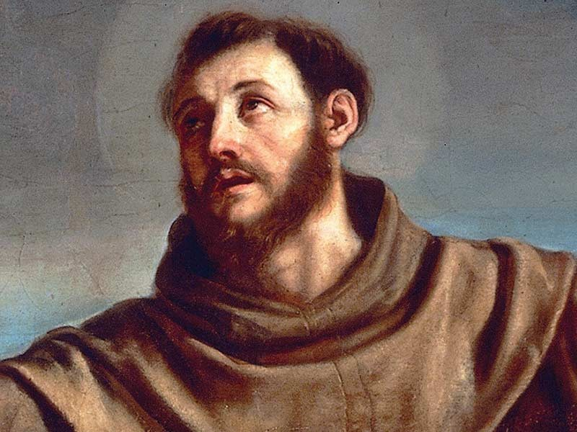
The Prayer of Saint Francis
Lord, make me an instrument of Your peace.
Where there is hatred, let me sow love;
Where there is injury, pardon;
Where there is doubt, faith;
Where there is despair, hope;
Where there is darkness, light;
Where there is sadness, joy.
O divine Master, grant that I may not so much seek
To be consoled as to console,
To be understood as to understand,
To be loved as to love;
For it is in giving that we receive;
It is in pardoning that we are pardoned;
It is in dying to self that we are born to eternal life
Amen

Slide 42
Leadership Challenges
Negativity is the enemy of Servant Leadership
Identify a person in your experience (NOT by name) who was the most negative
Then specify which type they were from the list below
1. The Resisters--They rail against anything different
2. The Wobbly —They are constantly shifting moods and expect others to adjust to them
3. The Gossipers--They spread rumors and tell inappropriate personal tidbits
4. The Blamers—They are constantly blaming others.

Slide 43
5. The Victims—They believe people are out to get them
6. The Adhesives--They can’t let go, even things that happened years ago
7. The Pessimists--They always expect the worst case scenario
8. The Boilers—They will blow over the slightest provocation
9. The Complainers—They feel everything is wrong or will soon go wrong
10. The Choosers—They are constantly pitting one group against another
11. The Detached-- They feel most everything is dumb or beneath them
12. The Self-Absorbed--They are constantly grabbing credit or attention

Slide 44
Conclusion
Questions or comments?

Slide 45
Servant Leadership
Lead Like Jesus
Thanks

